Slide 1

By, Fatima Vahidnezhad Course Name: DBDA.X404.(23) Data Analysis_ Introduction Batch: Summer 2020
ANALYSIS OF THE US ACCIDENTS AND SOLUTIONS
Predict accidents for future

Slide 2
Dataset
US-Accidents: A Countrywide Traffic Accident
Dataset,2020
https://www.kaggle.com/sobhanmoosavi/us-accidents

Slide 3

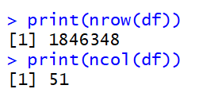

Samples
Interesting point of data: about 2 million accidents through 2 years.
Number of Samples
Number of accidents:
more than 100,000 records
Number of variables

Slide 4
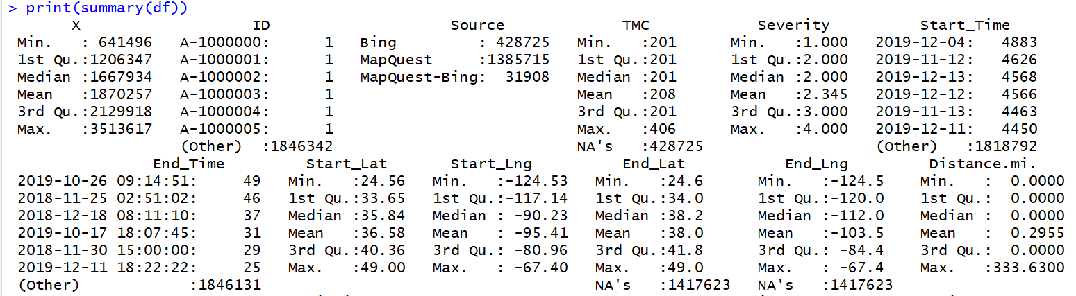
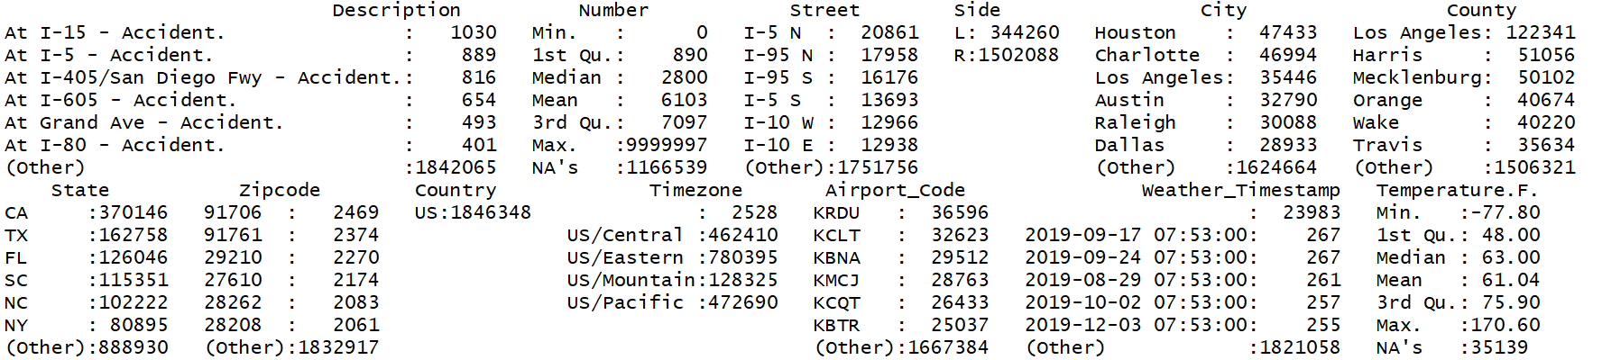
Summary of features: Geographical location in accidents

Slide 5

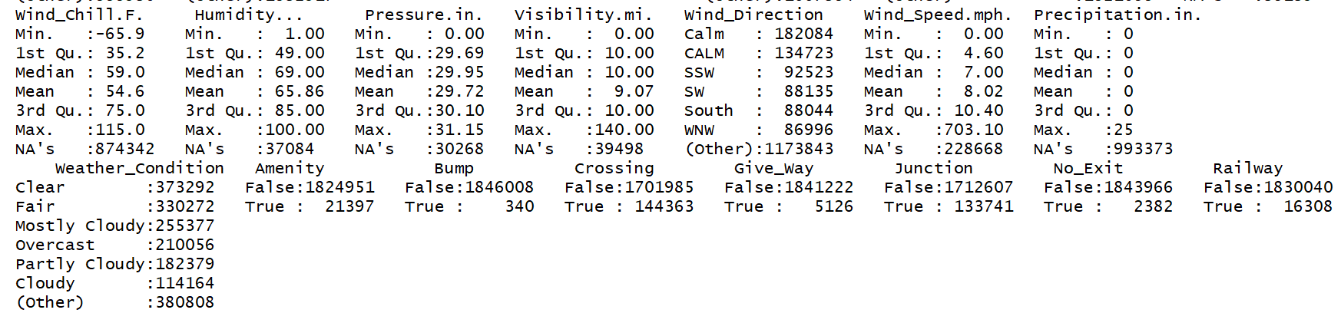
Summary of features: Weather condition during accidents
Numeric features

Slide 6
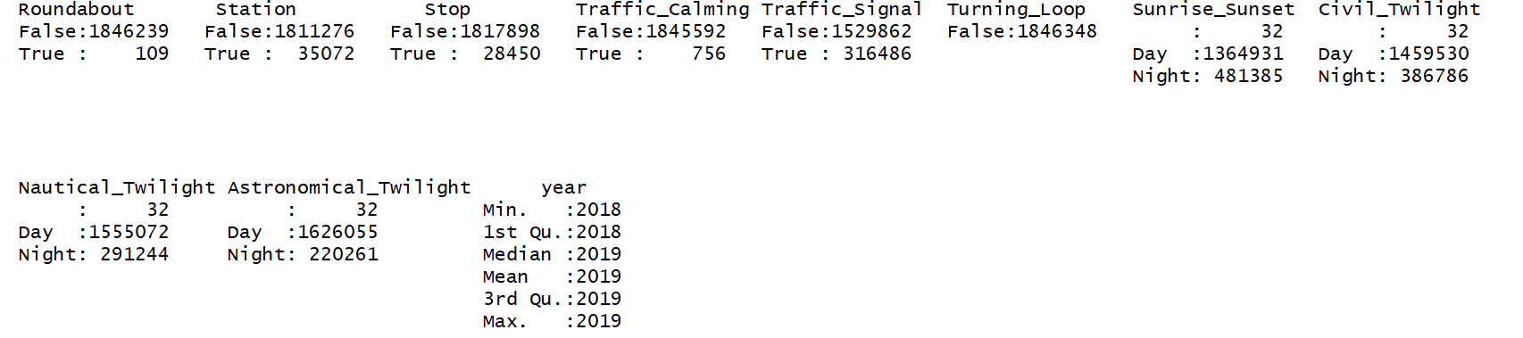
Summary of features: Location/Situation during accidents
Categorical features

Slide 7
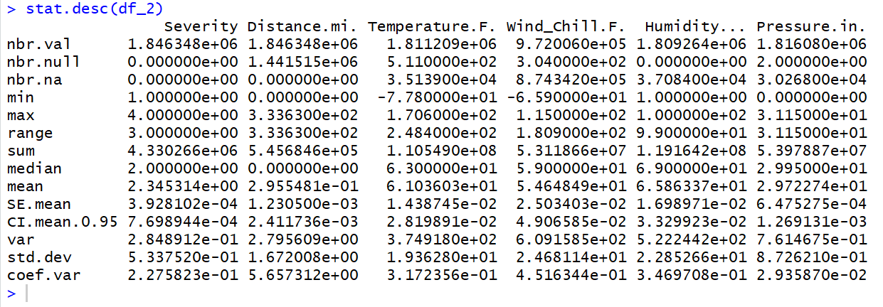
Descriptive statistics for numeric columns:
library(pastecs)

Slide 8
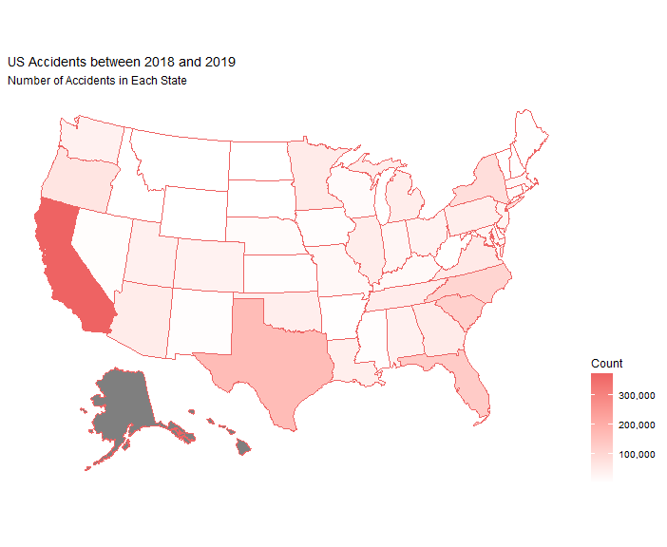

Number of Accidents in Each State
The highest number of accidents took place in California.
Notes:
We show the number of accidents by color, the highest number took place in California.

Slide 9
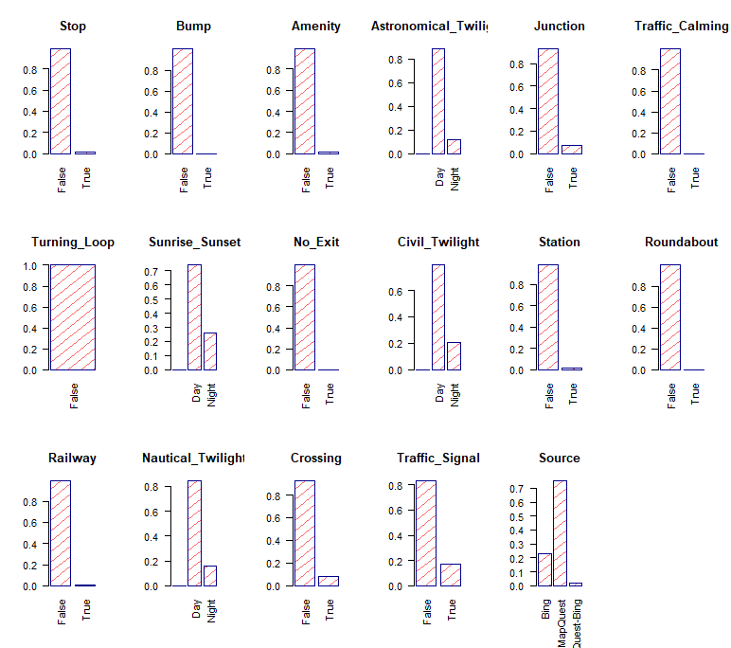
Relative Frequency of Categorical Variables
Notes:
The proportion of every value in binary columns, for example, about 90 percent of accidents took place in a situation that there is not any stop sign, station, junction and so on.

Slide 10
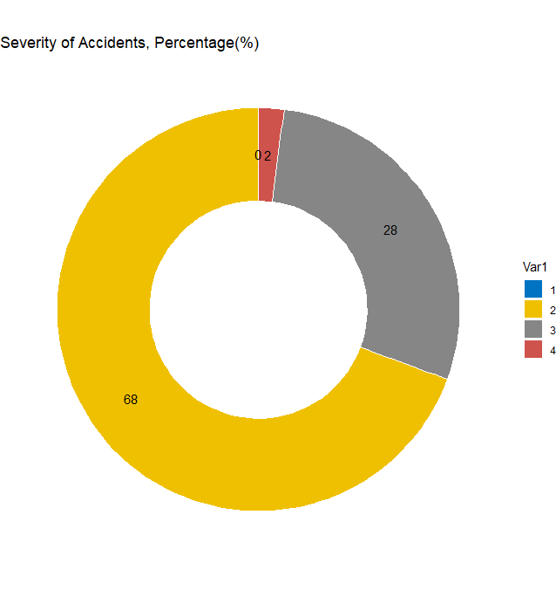


Target column:
Severity of accidents
The lowest Severity
The highest Severity
library(ggplot2)
Notes:
The percentage of the low severity accident and high severity was less than 2 percent, and nearly 70 percent of accidents were at the moderate level.

Slide 11
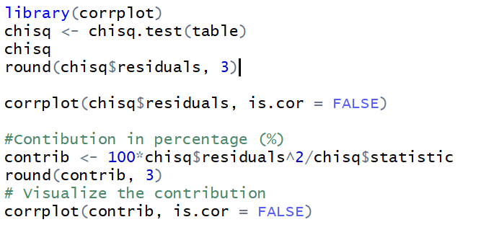
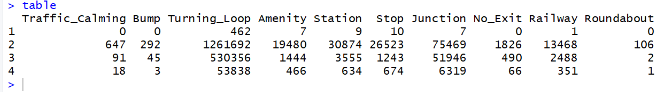
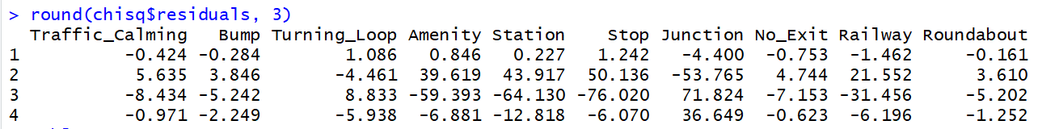
Chi-Square Test for finding dependency in categorial variables
Contingency table
library(corrplot)
Notes:
Contingency table between Severity of accidents and binary variables

Slide 12
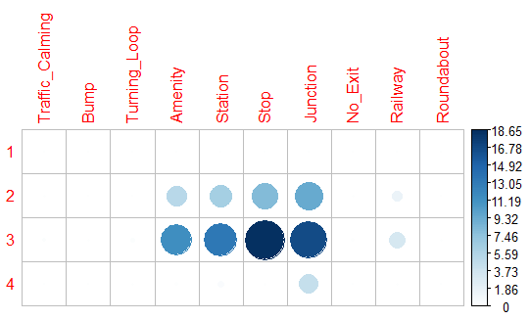
There is a correlation between the severity of accidents and these features: junction, stop, station, amenity
Correlation Matrix between Severity and the location of accidents
library(corrplot)
Notes:
Severity of accidents has a relationship with stop sign, amenity, junction and station in streets, it means that 70 percent of accidents took place near the junction, stop sign, amenity and stations.

Slide 13
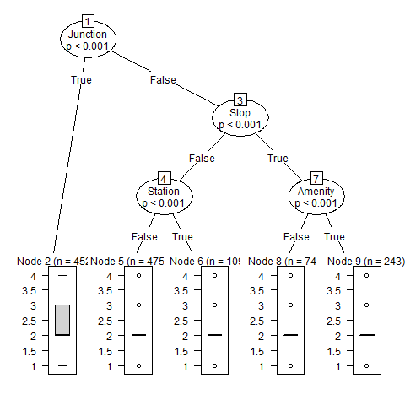
Result: If accidents take place near the junction, the severity of accidents is between 2 and 3. Otherwise, the severity is 2 (moderate level).
Decision tree algorithm

Slide 14
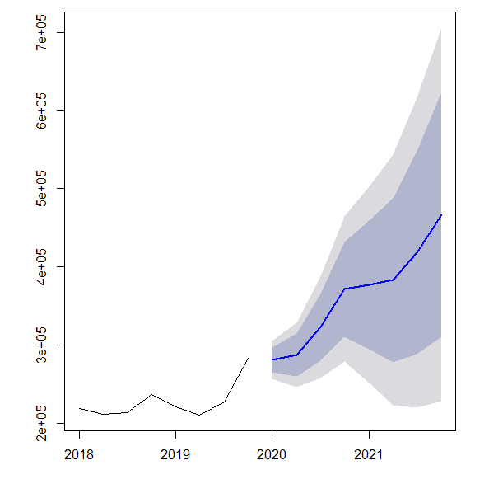
Forecast from Holt-Winters
library(forecast)
Notes:
We have the number of accidents for 2018 and 2019. This graph shows the frequency of accidents in the future.

Slide 15
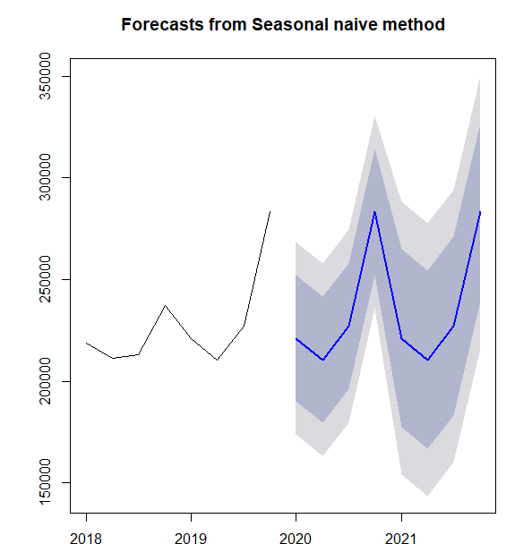
Forecast from Seasonal naïve method
library(forecast)
Notes:
It shows the trend of accident based on the behavior of accidents in the last seasons.

Slide 16
Conclusion
Predicting the trend of accidents for the future
The highest number of accidents took place in California
70 percent had a moderate level (2) in severity of accidents.
There is a relationship between some binary features and the severity of accidents
Binary features consist of stop sign, station, junction, and amenity in the streets.
70 percent of accidents took place near the junction, stop sign, amenity and stations.
Regarding decision tree algorithm, accidents near the junction has the severity level between 2 and 3. Otherwise, the severity level is 2 (moderate level).
The linear regression between some numeric variables and the number of accidents is not significant.

